Slide 1
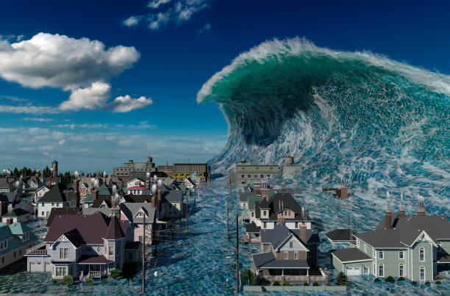
Tsunami
Data Analysis
By,
Manoj Yathindra Thagadur Srinivasu,
Xing Chen,
Zubair Ahmed Baig Mogal

Slide 2
Introduction:
An underwater earthquake, a volcano eruption or a landslide mostly causes a tsunami, Only on very few occasions a tsunami is caused by a giant meteor in the ocean. Tsunami waves can be as huge as 100 feet. About 80% of the tsunamis occur in the Pacific Ocean's Ring of Fire in the whole world

Slide 3
IEEE References:
Tsunami early warning system architecture based on automation technologies
https://ieeexplore.ieee.org/document/6917785
The occurrence of a tsunami after an earthquake in a coastal zone is very probable but not certain. This situation leads to a difficult decision about the best action to take: to evacuate or not.
Tsunami height forecast from water-level data
https://ieeexplore.ieee.org/document/968313
A methodology to forecast tsunami height based on real-time water-level data near the source is presented in this paper.
A Visualization Portal for a Tsunami Warning System on a Distributed Environment
https://ieeexplore.ieee.org/document/4617453
A web portal is used in a Tsunami warning system where a lot of tsunami cases are simulated in order to identify risk areas along the coast of Thailand.

Slide 4
Real-time tsunami reporting from the deep ocean
https://ieeexplore.ieee.org/document/572778
A 100-year historical database indicates that an average of five tsunamis per year occur in the Pacific and that during this period tsunamis have killed more than 50,000 people.
U.S. tsunami warning system: Capabilities, gaps, and future vision
https://ieeexplore.ieee.org/document/7404636
This paper examines the current state of the U.S. tsunami warning system and previews the science, technology, research, and development.
Preliminary Research in Tsunami Modelling-Leveraging Artificial Intelligence Technology
https://ieeexplore.ieee.org/document/9733726
The advent of modern supercomputers technology, in conjunction with larger, more comprehensive observation datasets, has led to a paradigm shift in early forecasting of Tsunami modeling.

Slide 5
Problem definition or hypothesis:
In this project, we are going to analyze the data of tsunami occurrences and impacts.
This dataset is also known as The Global Historical Tsunami Database, represents historical tsunamis and related information and provides information on over 2,400 tsunamis in the Atlantic, Indian, and Pacific Oceans; and the Mediterranean and Caribbean Seas.

Slide 6
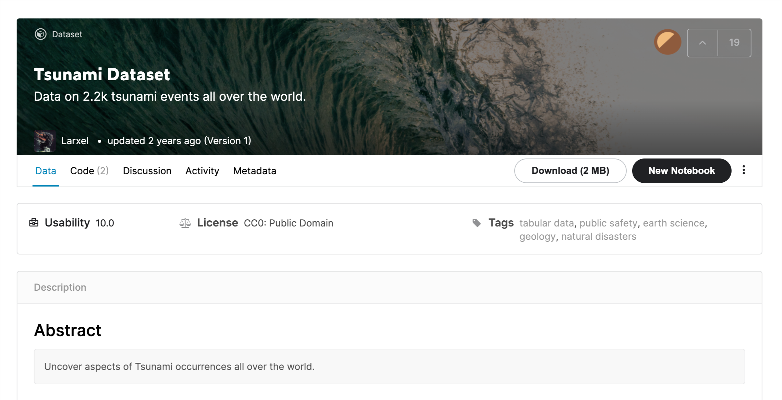
Dataset Used:
Tsunami Dataset
https://www.kaggle.com/andrewmvd/tsunami-dataset

Slide 7




Libraries and functions used:
Functions:
show_data()
drop_null_values()
plot_tsunami_country()
check_tsunami_country()
check_tsunami_year()
filter_df_by_year()
plot_tasunami_cause()
filter_tsunami_country()
show_scatter_plot()
show_correlation()
filter_correlation()
plot_country_damage()
show_pair_plot()
show_correlation()
show_heat_map()
filter_heat_map()
Libraries
Functions
show_column_names()
check_null_values()
check_duplicates()
plot_total_death()
check_outlier_intensity()
check_outlier_hist()
Data Analysis
Dataframes:
TsunamiDF
Classes:
Tsunami
Visualization

Slide 8
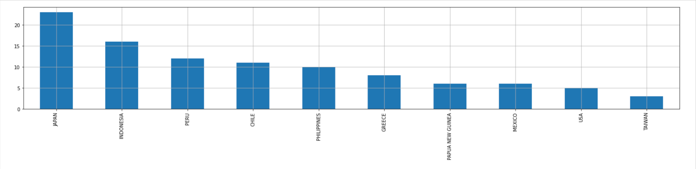
Tsunami Data EDA
1. Is there a significant difference in the frequency of Tsunami among Countries?
Top 10 Countries with most Tsunami in World
We can see in the top 10 having more number of Tsunami, Japan and Indonesia have significantly more Tsunami happened.

Slide 9
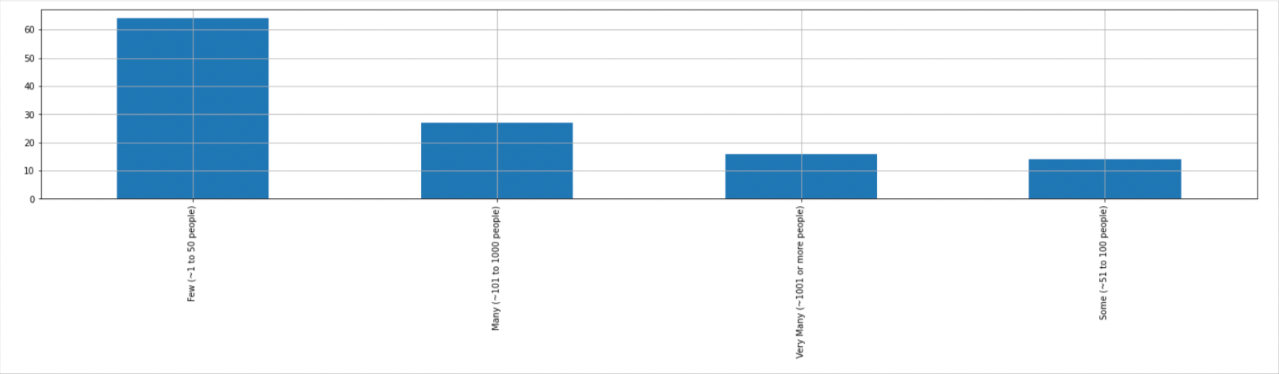
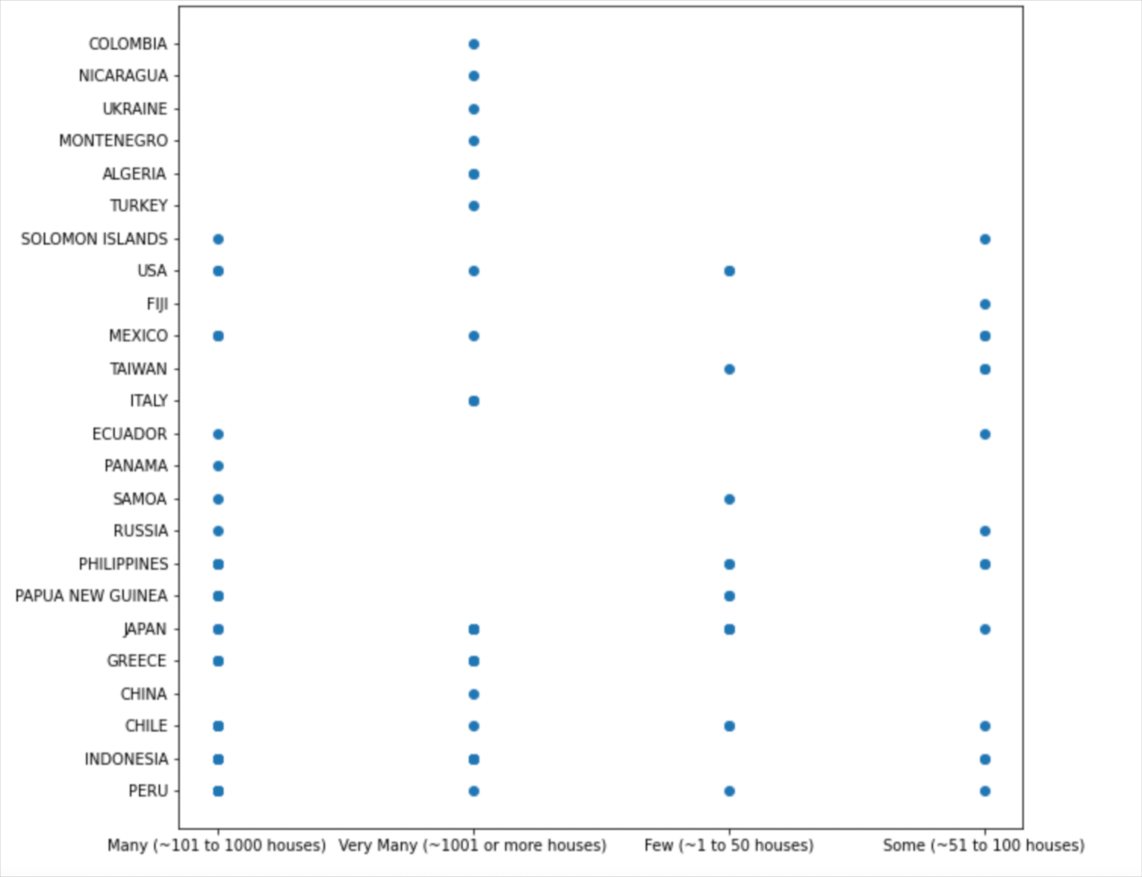
Tsunami Data EDA
2. How serious is the damage caused by Tsunami in Countries?
Image 1 Shows the number life lost in Tsunami and Image 2 shows the property damage in each country

Slide 10
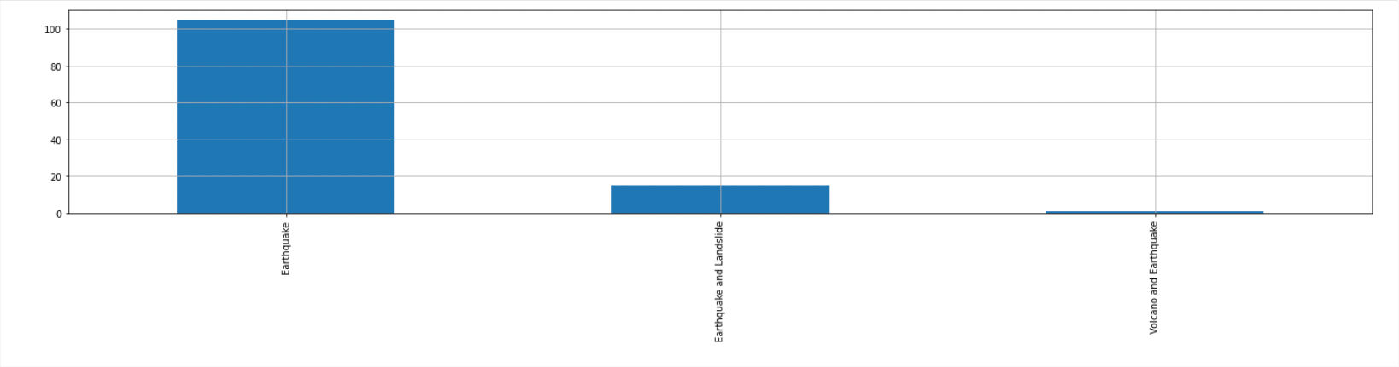
Tsunami Data EDA
3. What’s the relationship between other Natural Disaster?
Graph Shows other natural disaster influencing Tsunami

Slide 11
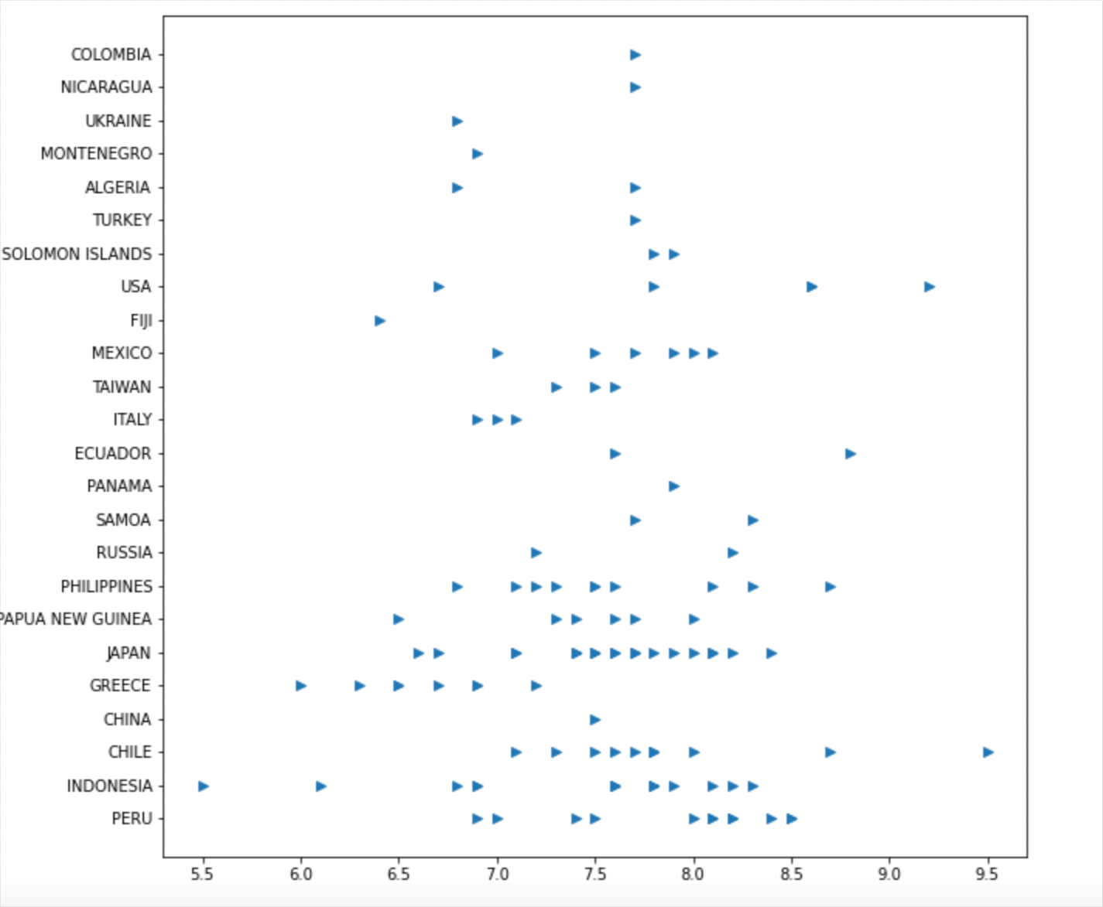
3. What’s the relationship between other Natural Disaster?
This graph shows the magnitude of earthquake caused during Tsunami of each country.

Slide 12
Results and conclusion:
1. Is there a significant difference in the frequency of Tsunami among Countries?
Yes, Japan and Indonesia got more Tsunami compared to other.
2. How serious is the damage caused by wildfire in counties?
Thousands of people lost life and thousands of property got damage.
3. What’s the relationship between other Natural Disaster?
Most of Tsunami Caused by Earthquake

Slide 13
THANK YOU!
ANY QUESTIONS?

